Slide 1
Computer Security:
Principles and Practice
Fourth Edition, Global Edition
By: William Stallings and Lawrie Brown
Notes:
Lecture slides prepared for “Computer Security: Principles and Practice”, 4/e, GE, by William Stallings and Lawrie Brown, Chapter 4 “Access Control”.

Slide 2
Chapter 4
Access Control
Notes:
We can view access control as a central element of computer security. The principal
objectives of computer security are to prevent unauthorized users from gaining
access to resources, to prevent legitimate users from accessing resources in an unauthorized
manner, and to enable legitimate users to access resources in an authorized
manner.
We begin this chapter with an overview of some important concepts. Next
we look at three widely used techniques for implementing access control policies.
We then turn to a broader perspective of the overall management of access control
using identity, credentials, and attributes. Finally, the concept of a trust framework
is introduced.

Slide 3
Access Control Definitions 1/2
NISTIR 7298 defines access control as:
“the process of granting or denying specific requests to: (1) obtain and use information and related information processing services; and (2) enter specific physical facilities”
Notes:
Two definitions of access control are useful in understanding its scope.
1. NISTIR 7298 (Glossary of Key Information Security Terms , May 2013), defines
access control as the process of granting or denying specific requests to: (1)
obtain and use information and related information processing services; and
(2) enter specific physical facilities.

Slide 4
Access Control Definitions 2/2
RFC 4949 defines access control as:
“a process by which use of system resources is regulated according to a security policy and is permitted only by authorized entities (users, programs, processes, or other systems) according to that policy”
Notes:
2. RFC 4949, Internet Security Glossary , defines access control as a process by
which use of system resources is regulated according to a security policy and
is permitted only by authorized entities (users, programs, processes, or other
systems) according to that policy.

Slide 5
Access Control Principles
Access control implements a security policy that specifies who or what (e.g., in the case of a process) may have access to each specific system resource, and the type of access that is permitted in each instance.
Notes:
In a broad sense, all of computer security is concerned with access control. Indeed,
RFC 4949 defines computer security as follows: measures that implement and assure
security services in a computer system, particularly those that assure access control
service. This chapter deals with a narrower, more specific concept of access control:
Access control implements a security policy that specifies who or what (e.g., in the
case of a process) may have access to each specific system resource, and the type of
access that is permitted in each instance.

Slide 6
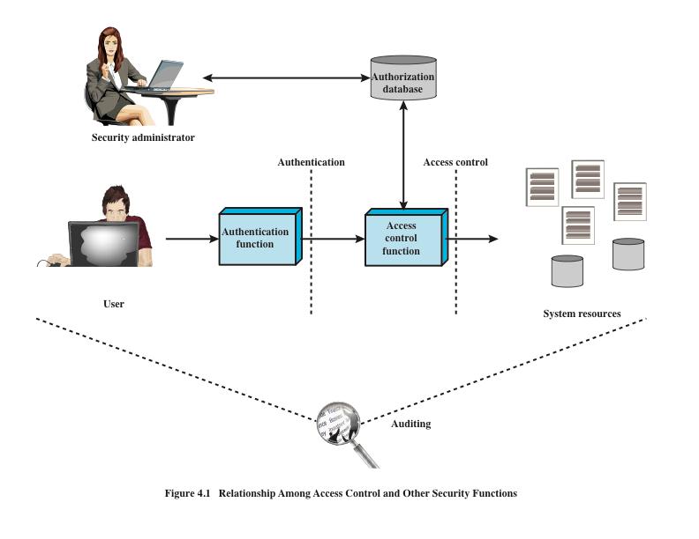
Source: Based on [SAND94].
Source: Based on [SAND94].
Notes:
Figure 4.1 shows a broader context of access control. In addition to access
control, this context involves the following entities and functions:
• Authentication: Verification that the credentials of a user or other system
entity are valid.
Authorization: The granting of a right or permission to a system entity to
access a system resource. This function determines who is trusted for a given
purpose.
• Audit: An independent review and examination of system records and activities
in order to test for adequacy of system controls, to ensure compliance with
established policy and operational procedures, to detect breaches in security,
and to recommend any indicated changes in control, policy and procedures.
An access control mechanism mediates between a user (or a process executing
on behalf of a user) and system resources, such as applications, operating systems,
firewalls, routers, files, and databases. The system must first authenticate an entity
seeking access. Typically, the authentication function determines whether the user
is permitted to access the system at all. Then the access control function determines
if the specific requested access by this user is permitted. A security administrator
maintains an authorization database that specifies what type of access to which
resources is allowed for this user. The access control function consults this database
to determine whether to grant access. An auditing function monitors and keeps a
record of user accesses to system resources.
In the simple model of Figure 4.1, the access control function is shown as
a single logical module. In practice, a number of components may cooperatively
share the access control function. All operating systems have at least a rudimentary,
and in many cases a quite robust, access control component. Add-on security
packages can supplement the native access control capabilities of the OS. Particular
applications or utilities, such as a database management system, also incorporate
access control functions. External devices, such as firewalls, can also provide access
control services.

Slide 7
Access Control Policies
Discretionary access control (DAC)
Controls access based on the identity of the requestor and on access rules (authorizations) stating what requestors are (or are not) allowed to do
Mandatory access control (MAC)
Controls access based on comparing security labels with security clearances
Role-based access control (RBAC)
Controls access based on the roles that users have within the system and on rules stating what accesses are allowed to users in given roles
Attribute-based access control (ABAC)
Controls access based on attributes of the user, the resource to be accessed, and current environmental conditions
Notes:
An access control policy, which can be embodied in an authorization database,
dictates what types of access are permitted, under what circumstances, and by
whom. Access control policies are generally grouped into the following categories:
• Discretionary access control (DAC): Controls access based on the identity
of the requestor and on access rules (authorizations) stating what requestors
are (or are not) allowed to do. This policy is termed discretionary because an
entity might have access rights that permit the entity, by its own volition, to
enable another entity to access some resource.
• Mandatory access control (MAC): Controls access based on comparing
security labels (which indicate how sensitive or critical system resources are)
with security clearances (which indicate system entities are eligible to access
certain resources). This policy is termed mandatory because an entity that has
clearance to access a resource may not, just by its own volition, enable another
entity to access that resource.
• Role-based access control (RBAC): Controls access based on the roles that
users have within the system and on rules stating what accesses are allowed to
users in given roles.
• Attribute-based access control (ABAC): Controls access based on attributes
of the user, the resource to be accessed, and current environmental
conditions.
DAC is the traditional method of implementing access control, and is examined
in Sections 4.3 and 4.4. MAC is a concept that evolved out of requirements for
military information security and is best covered in the context of trusted systems,
which we deal with in Chapter 27. Both RBAC and ABAC have become increasingly
popular, and are examined in Sections 4.5 and 4.6, respectively.
These four policies are not mutually exclusive. An access control mechanism
can employ two or even all three of these policies to cover different classes of system
resources.

Slide 8
Subjects, Objects, and Access Rights
Subject
Object
Access right
An entity capable of accessing objects
A resource to which access is controlled
Describes the way in which a subject may access an object
Three classes
Owner
Group
World
Entity used to contain and/or receive information
Could include:
Read
Write
Execute
Delete
Create
Search
Notes:
The basic elements of access control are: subject, object, and access right.
A subject is an entity capable of accessing objects. Generally, the concept of
subject equates with that of process. Any user or application actually gains access to
an object by means of a process that represents that user or application. The process
takes on the attributes of the user, such as access rights.
A subject is typically held accountable for the actions they have initiated,
and an audit trail may be used to record the association of a subject with security relevant
actions performed on an object by the subject.
Basic access control systems typically define three classes of subject, with
different access rights for each class:
• Owner: This may be the creator of a resource, such as a file. For system resources,
ownership may belong to a system administrator. For project resources, a project
administrator or leader may be assigned ownership.
• Group: In addition to the privileges assigned to an owner, a named group of
users may also be granted access rights, such that membership in the group is
sufficient to exercise these access rights. In most schemes, a user may belong
to multiple groups.
• World: The least amount of access is granted to users who are able to access the
system but are not included in the categories owner and group for this resource.
An object is a resource to which access is controlled. In general, an object
is an entity used to contain and/or receive information. Examples include records,
blocks, pages, segments, files, portions of files, directories, directory trees, mailboxes,
messages, and programs. Some access control systems also encompass, bits,
bytes, words, processors, communication ports, clocks, and network nodes.
The number and types of objects to be protected by an access control system
depends on the environment in which access control operates and the desired tradeoff
between security on the one hand and complexity, processing burden, and ease
of use on the other hand.
An access right describes the way in which a subject may access an object.
Access rights could include the following:
• Read: User may view information in a system resource (e.g., a file, selected
records in a file, selected fields within a record, or some combination). Read
access includes the ability to copy or print.
• Write: User may add, modify, or delete data in system resource (e.g., files,
records, programs). Write access includes read access.
• Execute: User may execute specified programs.
• Delete: User may delete certain system resources, such as files or records.
• Create: User may create new files, records, or fields.
• Search: User may list the files in a directory or otherwise search the directory.

Slide 9
Discretionary Access Control (DAC)
Scheme in which an entity may be granted access rights that permit the entity, by its own violation, to enable another entity to access some resource
Often provided using an access matrix
One dimension consists of identified subjects that may attempt data access to the resources
The other dimension lists the objects that may be accessed
Each entry in the matrix indicates the access rights of a particular subject for a particular object
Notes:
As was previously stated, a discretionary access control scheme is one in which an
entity may be granted access rights that permit the entity, by its own volition, to
enable another entity to access some resource. A general approach to DAC, as
exercised by an operating system or a database management system, is that of an
access matrix. The access matrix concept was formulated by Lampson [LAMP69,
LAMP71], and subsequently refined by Graham and Denning [GRAH72, DENN71]
and by Harrison et al. [HARR76].
One dimension of the matrix consists of identified subjects that may attempt
data access to the resources. Typically, this list will consist of individual users or
user groups, although access could be controlled for terminals, network equipment,
hosts, or applications instead of or in addition to users. The other dimension lists
the objects that may be accessed. At the greatest level of detail, objects may be
individual data fields. More aggregate groupings, such as records, files, or even the
entire database, may also be objects in the matrix. Each entry in the matrix indicates
the access rights of a particular subject for a particular object.

Slide 10
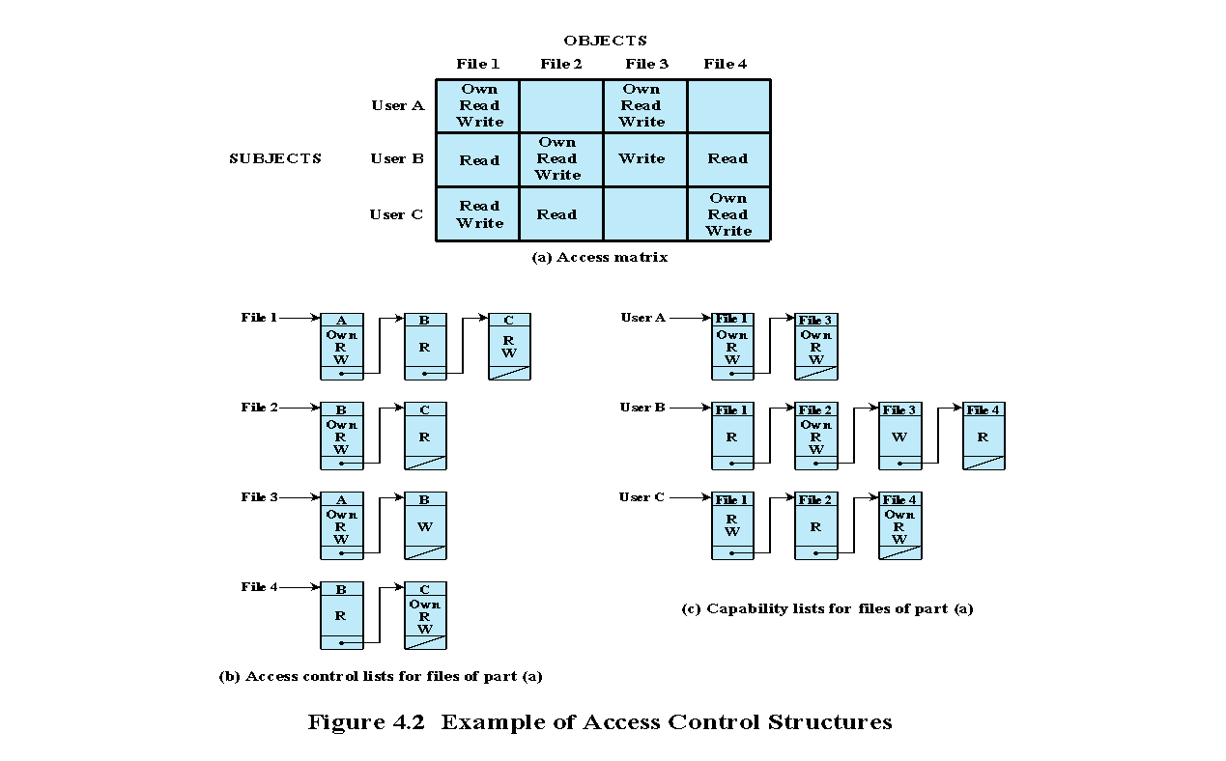
Figure 4.2 Example of Access Control Structures
Notes:
Figure 4.2a, based on a figure in [SAND94], is a simple example of an access
matrix. Thus, user A owns files 1 and 3 and has read and write access rights to those
files. User B has read access rights to file 1, and so on.

Slide 11
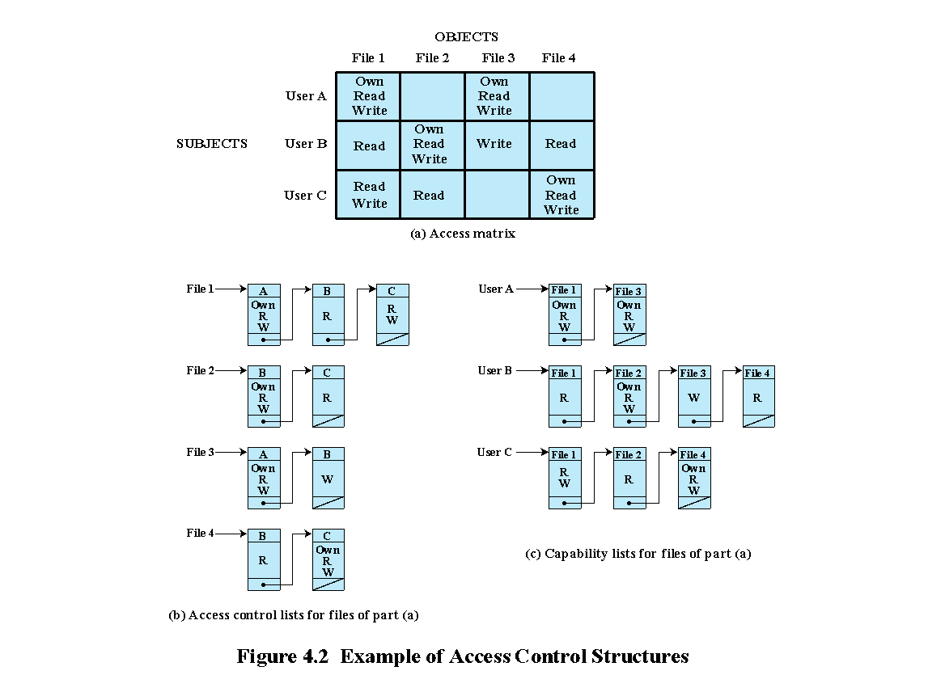
Notes:
In practice, an access matrix is usually sparse and is implemented by decomposition in one of two ways. The matrix may be decomposed by columns, yielding access control lists (ACLs); see Figure 4.2b. For each object, an ACL lists users and their permitted access rights. The ACL may contain a default, or public, entry. This allows users that are not explicitly listed as having special rights to have a default set of rights. The default set of rights should always follow the rule of least privilege or read-only access, whichever is applicable. Elements of the list may include individual users as well as groups of users.
When it is desired to determine which subjects have which access rights to a particular resource, ACLs are convenient, because each ACL provides the information for a given resource. However, this data structure is not convenient for determining the access rights available to a specific user.
Decomposition by rows yields capability tickets (Figure 4.2c). A capability
ticket specifies authorized objects and operations for a particular user. Each user
has a number of tickets and may be authorized to loan or give them to others.
Because tickets may be dispersed around the system, they present a greater
security problem than access control lists. The integrity of the ticket must be
protected, and guaranteed (usually by the operating system). In particular, the
ticket must be unforgeable. One way to accomplish this is to have the operating
system hold all tickets on behalf of users. These tickets would have to be held in
a region of memory inaccessible to users. Another alternative is to include an
unforgeable token in the capability. This could be a large random password, or a
cryptographic message authentication code. This value is verified by the relevant
resource whenever access is requested. This form of capability ticket is appropriate
for use in a distributed environment, when the security of its contents cannot
be guaranteed.
The convenient and inconvenient aspects of capability tickets are the opposite
of those for ACLs. It is easy to determine the set of access rights that a given user
has, but more difficult to determine the list of users with specific access rights for a
specific resource.

Slide 12
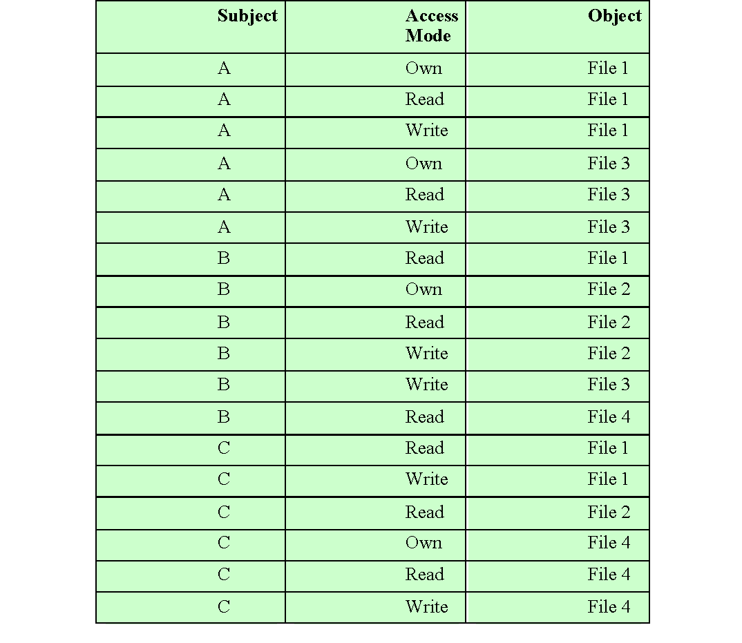
Table 4.2
Authorization Table
for Files in Figure 4.2
(Table is on page 113 in the textbook)
Notes:
[SAND94] proposes a data structure that is not sparse, like the access matrix,
but is more convenient than either ACLs or capability lists (Table 4.2). An authorization table contains one row for one access right of one subject to one resource. Sorting or accessing the table by subject is equivalent to a capability list. Sorting or accessing the table by object is equivalent to an ACL. A relational database can easily implement an authorization table of this type.

Slide 13
UNIX File Access Control
UNIX files are administered using inodes (index nodes)
Control structures with key information needed for a particular file
An active inode is associated with exactly one file
File attributes, permissions and control information are sorted in the inode
On the disk there is an inode table, or inode list, that contains the inodes of all the files in the file system
When a file is opened its inode is brought into main memory and stored in a memory resident inode table
Directories are structured in a hierarchical tree
May contain files and/or other directories
Contains file names plus pointers to associated inodes
Notes:
For our discussion of UNIX file access control, we first introduce several basic
concepts concerning UNIX files and directories.
All types of UNIX files are administered by the operating system by means of
inodes. An inode (index node) is a control structure that contains the key information
needed by the operating system for a particular file. Several file names may be
associated with a single inode, but an active inode is associated with exactly one file,
and each file is controlled by exactly one inode. The attributes of the file as well as
its permissions and other control information are stored in the inode. On the disk,
there is an inode table, or inode list, that contains the inodes of all the files in the file
system. When a file is opened, its inode is brought into main memory and stored in
a memory-resident inode table.
Directories are structured in a hierarchical tree. Each directory can contain
files and/or other directories. A directory that is inside another directory is referred
to as a subdirectory. A directory is simply a file that contains a list of file names plus
pointers to associated inodes. Thus, associated with each directory is its own inode.

Slide 14
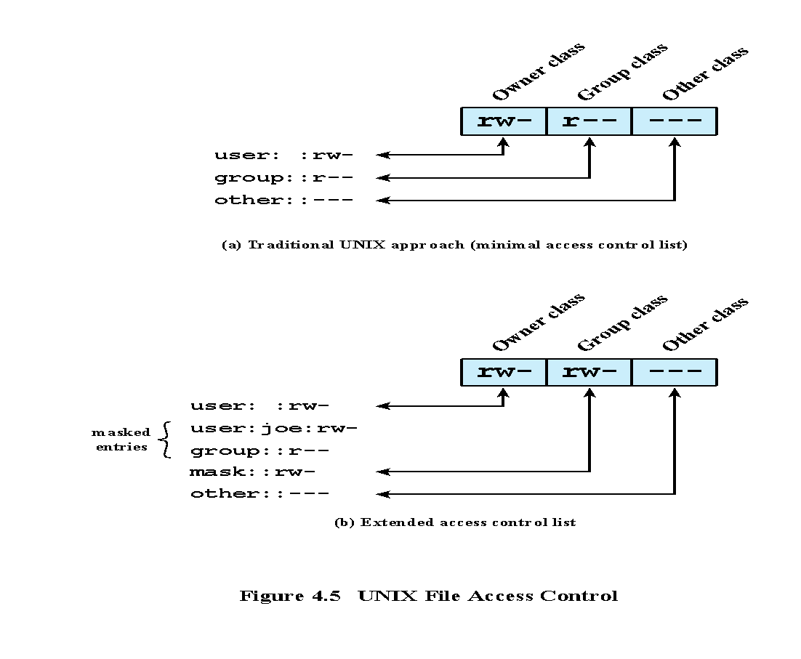
UNIX File Access Control
Unique user identification number (user ID)
Member of a primary group identified by a group ID
Belongs to a specific group
12 protection bits
Specify read, write, and execute permission for the owner of the file, members of the group and all other users
The owner ID, group ID, and protection bits are part of the file’s inode
Figure 4.5 UNIX File Access Control
Notes:
Most UNIX systems depend on, or at least are based on, the file access control
scheme introduced with the early versions of UNIX. Each UNIX user is assigned
a unique user identification number (user ID). A user is also a member of a primary
group, and possibly a number of other groups, each identified by a group ID.
When a file is created, it is designated as owned by a particular user and marked
with that user’s ID. It also belongs to a specific group, which initially is either its
creator’s primary group, or the group of its parent directory if that directory has
SetGID permission set. Associated with each file is a set of 12 protection bits. The
owner ID, group ID, and protection bits are part of the file’s inode.
Nine of the protection bits specify read, write, and execute permission for the
owner of the file, other members of the group to which this file belongs, and all other
users. These form a hierarchy of owner, group, and all others, with the highest relevant
set of permissions being used. Figure 4.5a shows an example in which the file owner has
read and write access; all other members of the file’s group have read access, and users
outside the group have no access rights to the file. When applied to a directory, the read
and write bits grant the right to list and to create/rename/delete files in the directory.
The execute bit grants to right to descend into the directory or search it for a filename.

Slide 15
Access Control Lists (ACLs) in UNIX
Modern UNIX systems support ACLs
FreeBSD, OpenBSD, Linux, Solaris
FreeBSD
Setfacl command assigns a list of UNIX user IDs and groups
Any number of users and groups can be associated with a file
Read, write, execute protection bits
A file does not need to have an ACL
When a process requests access to a file system object two steps are performed:
Step 1 selects the most appropriate ACL
Step 2 checks if the matching entry contains sufficient permissions
Notes:
Many modern UNIX and UNIX-based operating systems support access control
lists, including FreeBSD, OpenBSD, Linux, and Solaris. In this section, we describe
FreeBSD, but other implementations have essentially the same features and interface.
The feature is referred to as extended access control list, while the traditional
UNIX approach is referred to as minimal access control list.
FreeBSD allows the administrator to assign a list of UNIX user IDs and groups
to a file by using the setfacl command. Any number of users and groups can be
associated with a file, each with three protection bits (read, write, execute), offering a
flexible mechanism for assigning access rights. A file need not have an ACL but may be
protected solely by the traditional UNIX file access mechanism. Free BSD files include
an additional protection bit that indicates whether the file has an extended ACL.

Slide 16
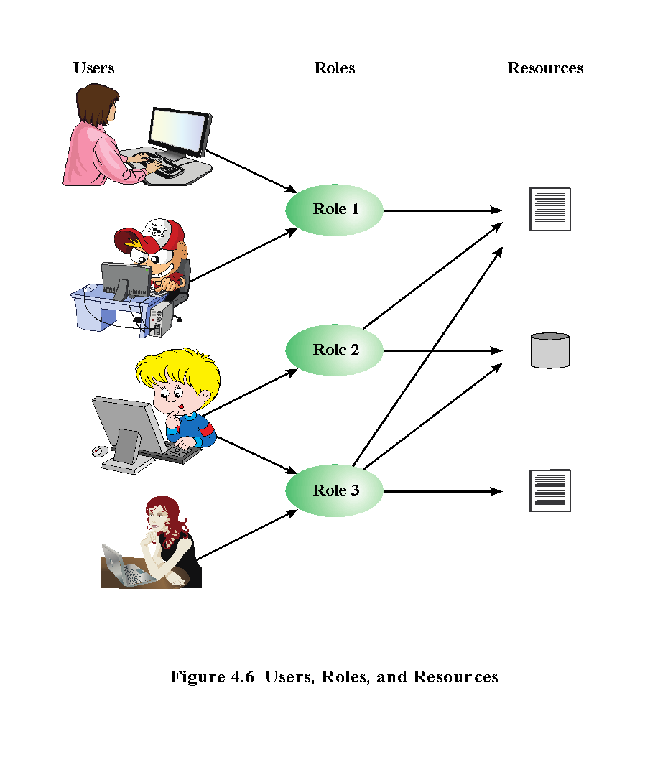
Notes:
Traditional DAC systems define the access rights of individual users and groups
of users. In contrast, RBAC is based on the roles that users assume in a system
rather than the user’s identity. Typically, RBAC models define a role as a job function
within an organization. RBAC systems assign access rights to roles instead of
individual users. In turn, users are assigned to different roles, either statically or
dynamically, according to their responsibilities.
RBAC now enjoys widespread commercial use and remains an area of active
research. The National Institute of Standards and Technology (NIST) has issued a
standard, FIPS PUB 140-3, (Security Requirements for Cryptographic Modules September 2009),
that requires support for access control and administration through roles.
The relationship of users to roles is many to many, as is the relationship of
roles to resources, or system objects (Figure 4.6). The set of users changes, in some
environments frequently, and the assignment of a user to one or more roles may
also be dynamic. The set of roles in the system in most environments is relatively
static, with only occasional additions or deletions. Each role will have specific access
rights to one or more resources. The set of resources and the specific access rights
associated with a particular role are also likely to change infrequently.

Slide 17
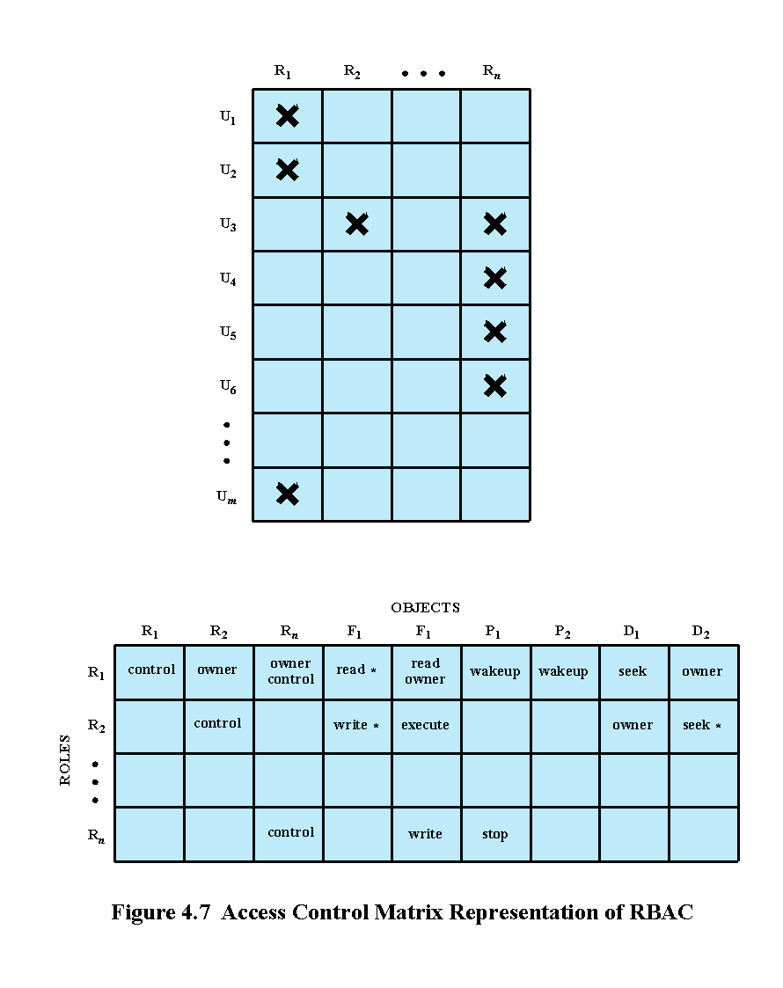
Notes:
We can use the access matrix representation to depict the key elements of an
RBAC system in simple terms, as shown in Figure 4.7. The upper matrix relates
individual users to roles. Typically there are many more users than roles. Each matrix
entry is either blank or marked, the latter indicating that this user is assigned to this
role. Note that a single user may be assigned multiple roles (more than one mark in a
row) and that multiple users may be assigned to a single role (more than one mark in
a column). The lower matrix has the same structure as the DAC access control matrix,
with roles as subjects. Typically, there are few roles and many objects, or resources.
In this matrix the entries are the specific access rights enjoyed by the roles. Note that a
role can be treated as an object, allowing the definition of role hierarchies.
RBAC lends itself to an effective implementation of the principle of least
privilege, referred to in Chapter 1. Each role should contain the minimum set of
access rights needed for that role. A user is assigned to a role that enables him or her
to perform only what is required for that role. Multiple users assigned to the same
role, enjoy the same minimal set of access rights.

Slide 18
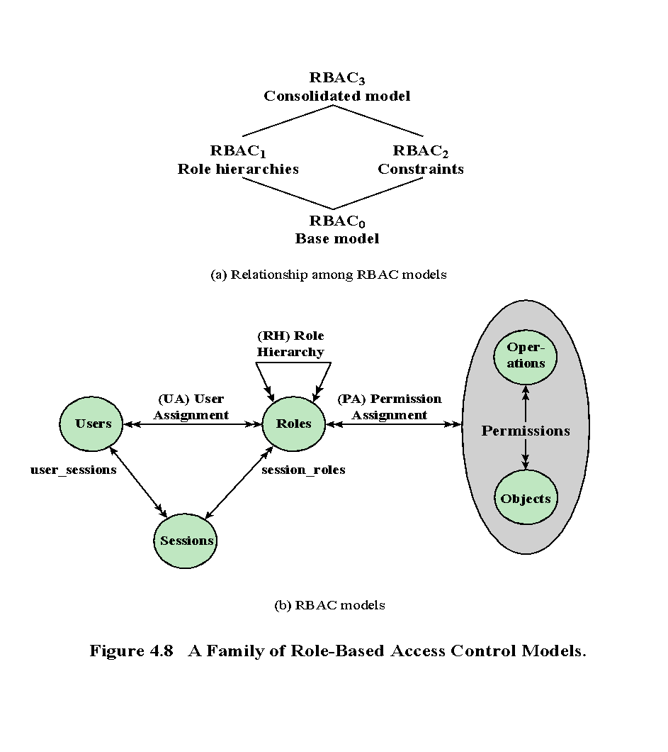
Notes:
A variety of functions and services can be included under the general RBAC
approach. To clarify the various aspects of RBAC, it is useful to define a set of
abstract models of RBAC functionality.
[SAND96] defines a family of reference models that has served as the basis
for ongoing standardization efforts. This family consists of four models that are
related to each other as shown in Figure 4.8a. and Table 4.4. RBAC₀ contains the
minimum functionality for an RBAC system. RBAC₁ includes the RBAC₀ functionality
and adds role hierarchies, which enable one role to inherit permissions
from another role. RBAC₂ includes RBAC₀ and adds constraints, which restrict
the ways in which the components of a RBAC system may be configured. RBAC₃
contains the functionality of RBAC₀, RBAC₁, and RBAC₂.
RBAC₀ Figure 4.8b, without the role hierarchy and constraints,
contains the four types of entities in an RBAC₀ system:
• User: An individual that has access to this computer system. Each individual
has an associated user ID.
Role: A named job function within the organization that controls this computer
system. Typically, associated with each role is a description of the authority and
responsibility conferred on this role, and on any user who assumes this role.
• Permission: An approval of a particular mode of access to one or more objects.
Equivalent terms are access right, privilege, and authorization.
• Session: A mapping between a user and an activated subset of the set of roles
to which the user is assigned.
The arrowed lines in Figure 4.8b indicate relationships, or mappings, with a
single arrowhead indicating one and a double arrowhead indicating many. Thus,
there is a many-to-many relationship between users and roles: One user may have
multiple roles, and multiple users may be assigned to a single role. Similarly, there
is a many-to-many relationship between roles and permissions. A session is used to
define a temporary one-to-many relationship between a user and one or more of the
roles to which the user has been assigned. The user establishes a session with only the
roles needed for a particular task; this is an example of the concept of least privilege.
The many-to-many relationships between users and roles and between roles
and permissions provide a flexibility and granularity of assignment not found in
conventional DAC schemes. Without this flexibility and granularity, there is a greater
risk that a user may be granted more access to resources than is needed because
of the limited control over the types of access that can be allowed. The NIST RBAC
document gives the following examples: Users may need to list directories and modify
existing files without creating new files, or they may need to append
records to a file without modifying existing records.

Slide 19
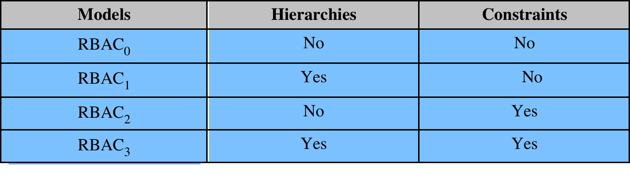
Table 4.4 Scope RBAC Models
Notes:
Scope RBAC Models.

Slide 20
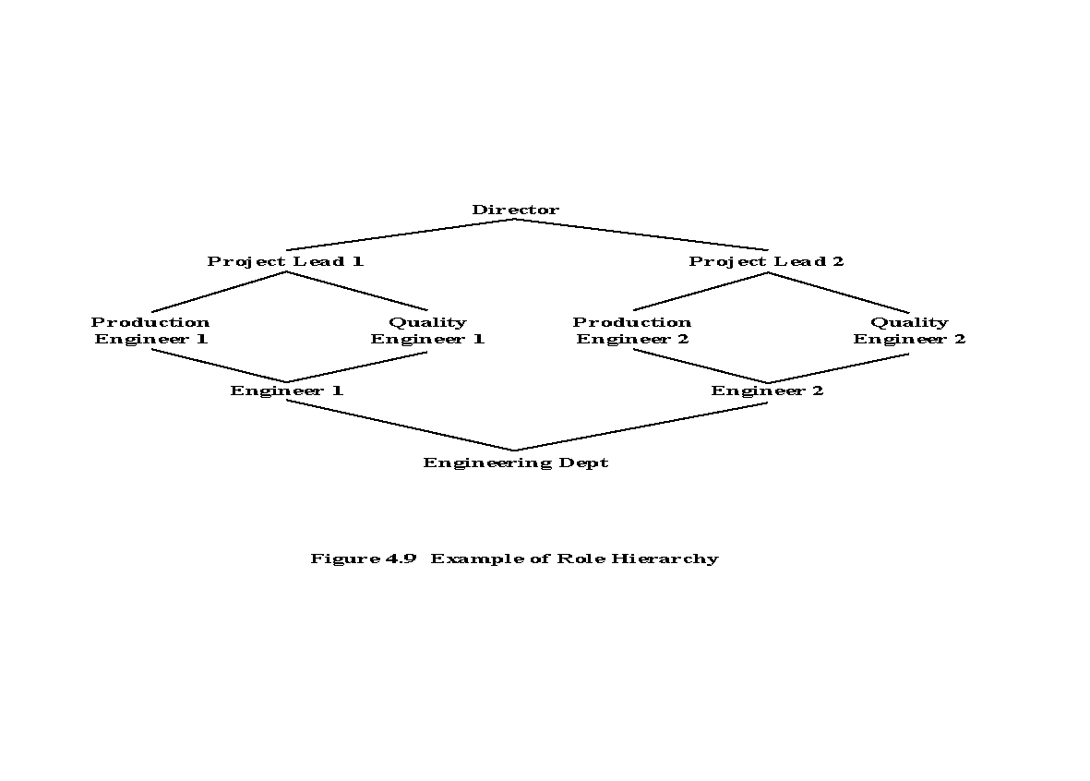
Notes:
Role hierarchies provide a means of reflecting
the hierarchical structure of roles in an organization. Typically, job functions with
greater responsibility have greater authority to access resources. A subordinate job
function may have a subset of the access rights of the superior job function. Role
hierarchies make use of the concept of inheritance to enable one role to implicitly
include access rights associated with a subordinate role.
Figure 4.9 is an example of a diagram of a role hierarchy. By convention, subordinate
roles are lower in the diagram. A line between two roles implies that the
upper role includes all of the access rights of the lower role, as well as other access
rights not available to the lower role. One role can inherit access rights from multiple
subordinate roles. For example, in Figure 4.9, the Project Lead role includes all of
the access rights of the Production Engineer role and of the Quality Engineer role.
More than one role can inherit from the same subordinate role. For example, both
the Production Engineer role and the Quality Engineer role include all of the access
rights of the Engineer role. Additional access rights are also assigned to the Production
Engineer Role and a different set of additional access rights are assigned to the
Quality Engineer role. Thus, these two roles have overlapping access rights, namely
the access rights they share with the Engineer role.

Slide 21
Constraints - RBAC
Provide a means of adapting RBAC to the specifics of administrative and security policies of an organization
A defined relationship among roles or a condition related to roles
Types:
Mutually exclusive roles
Cardinality
Prerequisite roles
A user can only be assigned to one role in the set (either during a session or statically)
Any permission (access right) can be granted to only one role in the set
Setting a maximum number with respect to roles
Dictates that a user can only be assigned to a particular role if it is already assigned to some other specified role
Notes:
Constraints provide a means of adapting RBAC to the
specifics of administrative and security policies in an organization. A constraint is
a defined relationship among roles or a condition related to roles. [SAND96] lists
the following types of constraints: mutually exclusive roles, cardinality, and prerequisite
roles.
Mutually exclusive roles are roles such that a user can be assigned to only
one role in the set. This limitation could be a static one, or it could be dynamic, in
the sense that a user could be assigned only one of the roles in the set for a session.
The mutually exclusive constraint supports a separation of duties and capabilities
within an organization. This separation can be reinforced or enhanced by use of
mutually exclusive permission assignments. With this additional constraint, a mutually
exclusive set of roles has the following properties:
1. A user can only be assigned to one role in the set (either during a session or
statically).
2. Any permission (access right) can be granted to only one role in the set.
Thus the set of mutually exclusive roles have non-overlapping permissions. If two
users are assigned to different roles in the set, then the users have non-overlapping
permissions while assuming those roles. The purpose of mutually exclusive roles is to
increase the difficulty of collusion among individuals of different skills or divergent job
functions to thwart security policies.
Cardinality refers to setting a maximum number with respect to roles. One
such constraint is to set a maximum number of users that can be assigned to a given
role. For example, a project leader role or a department head role might be limited
to a single user. The system could also impose a constraint on the number of roles
that a user is assigned to, or the number of roles a user can activate for a single session.
Another form of constraint is to set a maximum number of roles that can be
granted a particular permission; this might be a desirable risk mitigation technique
for a sensitive or powerful permission.
A system might be able to specify a prerequisite role, which dictates that a user can
only be assigned to a particular role if it is already assigned to some other specified
role. A prerequisite can be used to structure the implementation of the least privilege
concept. In a hierarchy, it might be required that a user can be assigned to a senior
(higher) role only if it is already assigned an immediately junior (lower) role. For
example, in Figure 4.9 a user assigned to a Project Lead role must also be assigned
to the subordinate Production Engineer and Quality Engineer roles. Then, if the user
does not need all of the permissions of the Project Lead role for a given task, the user
can invoke a session using only the required subordinate role. Note that the use of
prerequisites tied to the concept of hierarchy requires the RBAC₃ model.

Slide 22
Summary
Access control principles
Access control context
Access control policies
Subjects, objects, and access rights
Discretionary access control
UNIX file access control
Traditional UNIX file access control
Access control lists in UNIX
Role-based access control
RBAC reference models
Notes:
Chapter 4 summary.

